Slide 1

Rockbuster Stealth
Data Analysis
By: Emmanuel Eju

Slide 2
Project Overview
Rockbuster Stealth LLC is a movie rental company that used to have stores around the world. Facing stiff competition from streaming services such as Netflix and Amazon Prime, the Rockbuster Stealth management team is planning to use its existing movie licenses to launch an online video rental service in order to stay competitive.

Slide 3
Objectives/Questions
Genre Analysis
● Which movies contributed the most/least to revenue gain?
Rental Analysis
● What was the average rental duration for all videos?
Location Analysis
● Which countries are Rockbuster customers based in?
Customer Analysis
● Where are customers with a high lifetime value based?
Spatial Analysis
● Do sales figures vary between geographic regions?

Slide 4
Company Overview
TOTAL CUSTOMERS: 599 CUSTOMERS
FILMS FOR RENT: 1000 FILMS
AVERAGE RENTAL DURATION: 5 DAYS
AVERAGE RENTAL COST: $2.98
AVERAGE REPLACEMENT: $19.98

Slide 5
Film Analysis Bottom 5 Films Top 5 Films

Slide 6
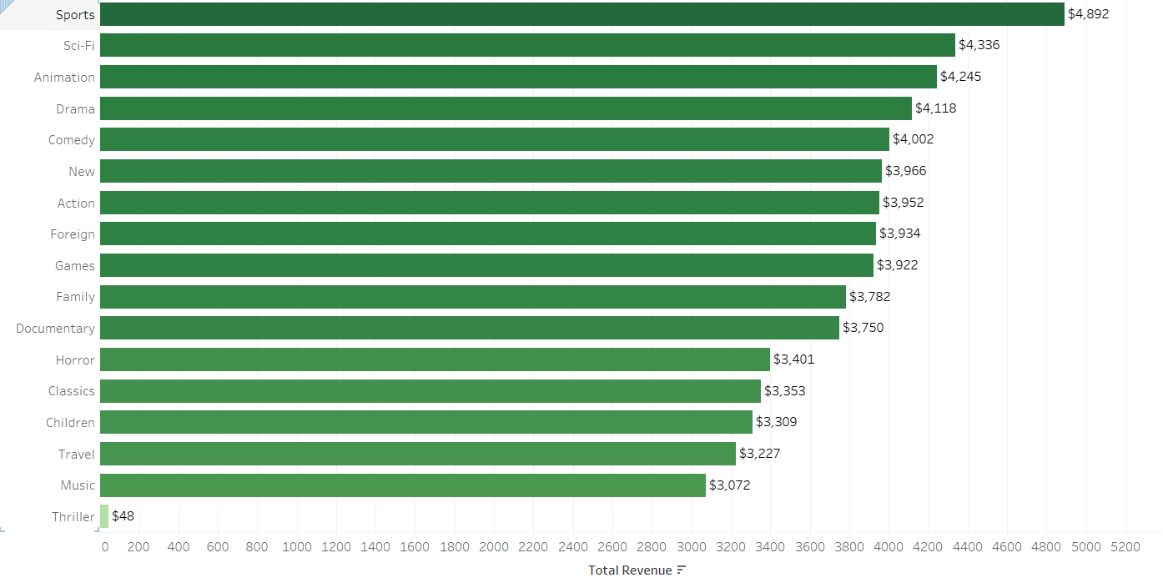
Total Revenue Generated by Genre
Sports, Sci-fi, Animation, Drama and Comedy are the top five genre that generated the most revenue while Thriller performs significantly low in terms of revenue generated.

Slide 7
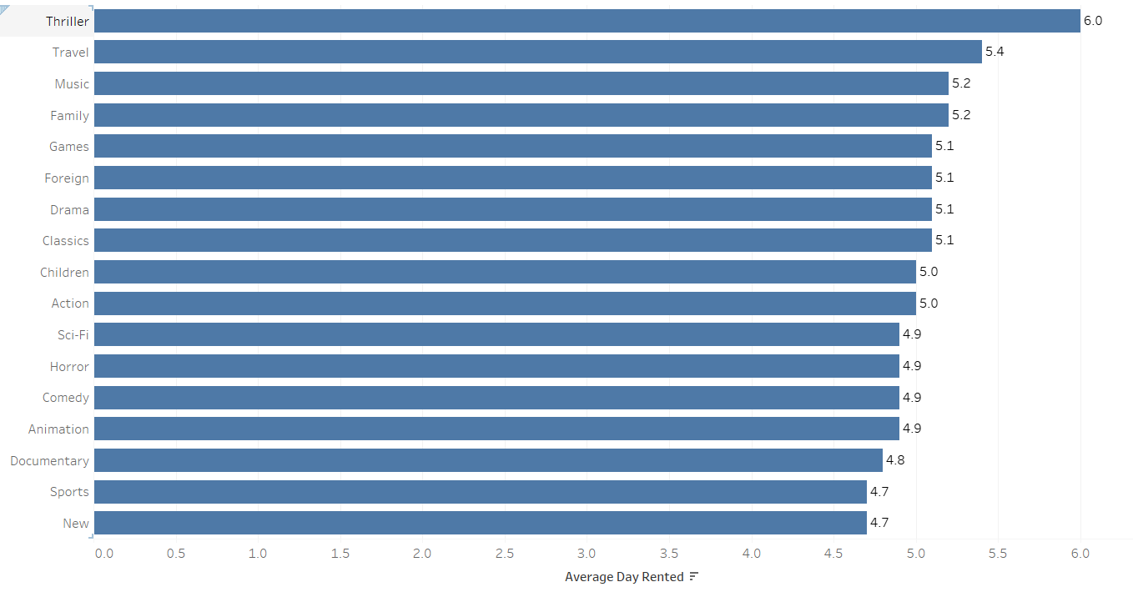
Rental Duration Analysis
Rental duration is relatively consistent across genre.
The thriller genre has the longest rental but generated the least revenue.
The average rental duration is 5 days.

Slide 8
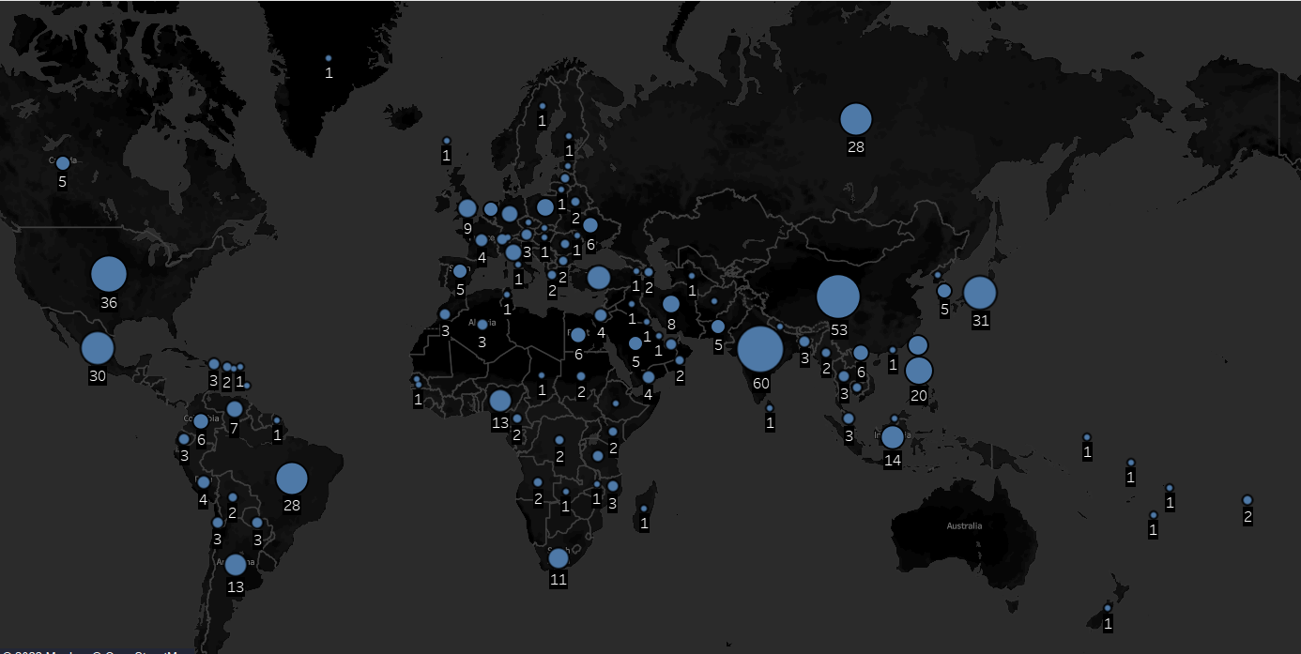
Total Number of Rockbuster Stealth LLC Customers per Country.
There are a total of 599 customers worldwide in 109 countries with India having the most customers(68 customers), China second highest(53 customers) and United States third(36 customers).

Slide 9
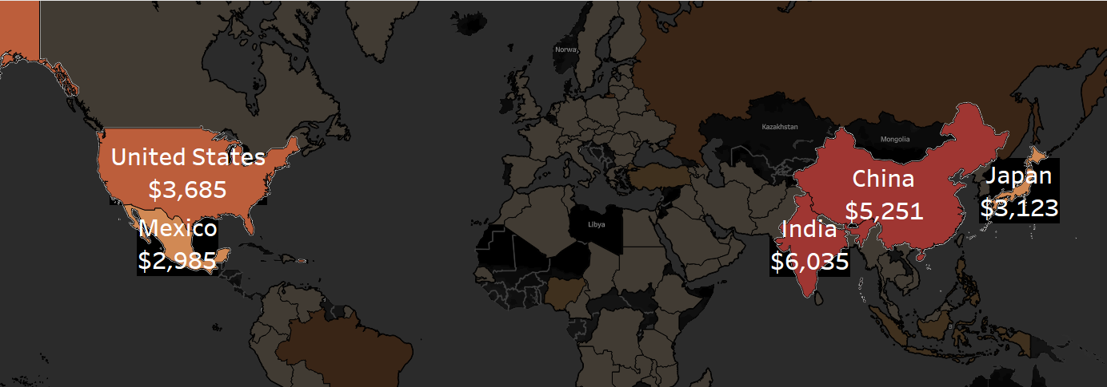
Top 5 countries by Revenue Generated.
India has the highest revenue volume; China has the second largest revenue and United has the third revenue volume.

Slide 10
Customer Analysis Top customer, Eleanor Hunt, is not located in of the top 5 countries and only one of the top 5 countries for revenue( United States) has one of the top 5 customers

Slide 11
Recommendations
Top customers should be rewarded with discounts or loyalty card. A card that gets them better deals for patronising Rockbuster Stealth. This will help to retain the customers and also lure new customers.
Target geographical locations with high customer count to gain more customers.
Create a platform for customers for their feedbacks and rating of movies . This feedback guides improvements of the customer experience and can empower positive change.
Suggestion
Thriller has the highest average rental rent but significantly low revenue compared to other genre and I recommend further research on this finding.

